Slide 1


LAKE DORIAN SUMMER VILLAGE
THE BASICS OF BEING OUTDOORS
Beginner Skills You Should Know

Slide 2


Why the Wilderness?
How to Survive Outdoors
What We Can Teach
Basic Skills for Beginners
Things to Remember
Who We Are
Basic FAQs
PRESENTATION OUTLINE

Slide 3
WHY THE WILDERNESS?
Presentations are communication tools that can be used as demonstrations, lectures, speeches, reports, and more.

Slide 4
ADVANCED
SURVIVAL SKILLS
BASIC SURVIVAL SKILLS
Presentations are
communication tools.
Presentations are
communication tools.

Slide 5

KNOW YOUR SKILLS
HOW TO SURVIVE OUTDOORS
Presentations are communication tools.
CONTROL YOUR ATTITUDE
Presentations are communication tools.
MAKE A PLAN
Presentations are communication tools.

Slide 6
ALEJANDRO LAWTON
WHO IS HE?
Presentations are communication tools that can be used as demonstrations.
WHAT DOES HE DO?
Presentations are communication tools that can be used as demonstrations.

Slide 7
DID YOU KNOW?
2/10
PEOPLE ARE CONFIDENT IN THEIR SURVIVAL SKILLS

Slide 8
96%
87%
OF PEOPLE USE THEIR SURVIVAL SKILLS FOR RECREATIONAL CAMPING
OF PEOPLE LOST OUTDOORS GET FOUND

Slide 9
YOUTH ENGAGEMENT IN THE OUTDOORS
40
30
20
A TREND OF GROWTH
10
Presentations are communication tools that can be used as demonstrations, lectures, speeches, reports, and more.
0
Item 1
Item 2
Item 3
Item 4

Slide 10


BUILDING A FIRE
FINDING CLEAN WATER
Presentations are communication tools that can be used as demonstrations.
Presentations are communication tools that can be used as demonstrations.
BUILDING A SHELTER
FINDING FOOD
Presentations are communication tools that can be used as demonstrations.
Presentations are communication tools that can be used as demonstrations.

Slide 11
WHY DO WE LEARN?
To Find Adventure
For Survival
To Save a Life
For Recreation

Slide 12
RECREATIONAL OUTDOOR SKILLS
BEGINNER TIPS AND TECHNIQUES

Slide 13
THINGS TO REMEMBER
CHECK YOUR SUPPLIES
STOCK UP ON ESSENTIALS
PLAN AHEAD
Presentations are communication tools.
Presentations are communication tools.
Presentations are communication tools.

Slide 14
CHOOSE YOUR SITE
BUILD A FIRE
FIND CLEAN WATER
Presentations are communication tools.
Presentations are communication tools.
Presentations are communication tools.

Slide 15
ESTABLISHING YOUR CAMP SITE
IS IT SAFE?
WHAT ARE THE
AMENITIES?
WHAT CAN YOU DO IN EMERGENCIES?
Presentations are communication tools that can be used as lectures, speeches, and reports.
Presentations are communication tools that can be used as lectures, speeches, and reports.
Presentations are communication tools that can be used as lectures, speeches, and reports.

Slide 16
BASIC SURVIVAL SKILLS
Presentations are communication tools that can be used as demonstrations, lectures, speeches, reports, and more. Most of the time, they’re presented before an audience.

Slide 17
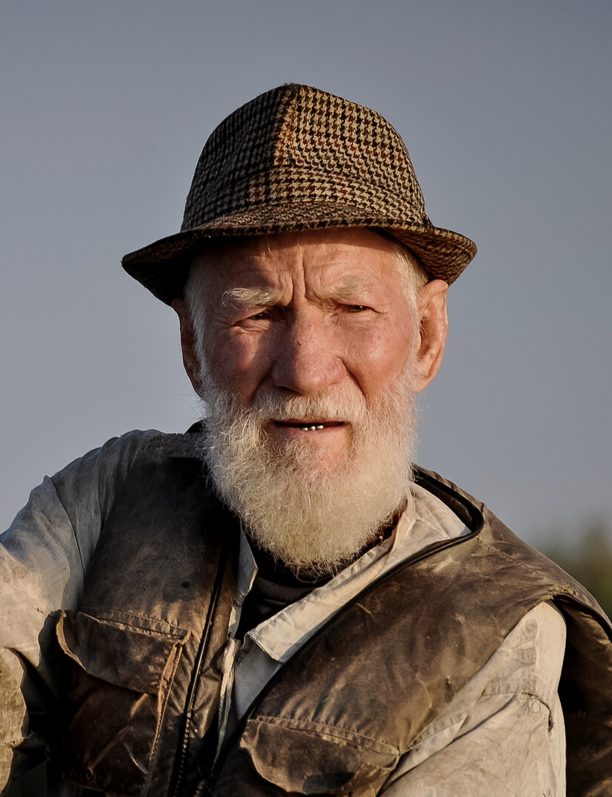

OSCAR HUTTON
OLIVIA JOOLES
ANDREW WALLACE
Former Camper
Nature Enthusiast
Professional Guide

Slide 18
BASIC FAQS
CAN I DO IT MYSELF?
Presentations are communication tools.
WHAT ARE THE THINGS I NEED?
Presentations are communication tools.
HOW CAN I LEARN MORE?
Presentations are communication tools.

